Slide 1
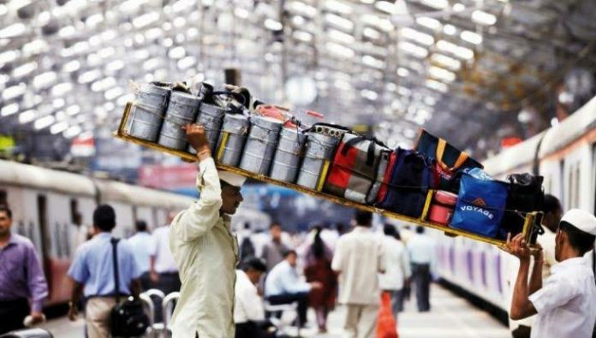
Starting Dabbawala service in Kolkata

Slide 2
About Dabbawala service
It has been a Topic of many research papers. Even Harvard Business School added the case study The Dabbawala System: On-Time Delivery, Every Time to their compendium for its high level of service with a low-cost and simple operating system.
Dabba means Tiffin/Lunch Box in local language
It is a famous Tiffin delivery service of Mumbai
Home cooked fresh meal.
House wives cook for their family and the same food is served in Tiffin.
No mass scale cooking.
Quality food made with utmost care.
Very low cost.
The Dabbawalas are the one who collect the Dabbas/Tiffin from the cook’s home and delivers them to the office places.

Slide 3
Dabbawalas
They almost always commute through train.
Trains are the cheapest mode of communication in India.
Network of Dabbawalas operates in sync to deliver the dabbas to the destiny on time.
They operates according to train timings.
Exchanges of the tiffin from one dabbawala to the other happens in the train stations.
Simple color coded stickers are used to distinguish the destination station and delivery point.
The destinations are not very far from the stations as the dabbawalas would cover the distance by walking or by bycycles.

Slide 4
Business Problem:
Despite the popularity of the service in Mumbai, it is not replicated in other cities like Kolkata.
Kolkata too like Mumbai has very good local train connectivity
A huge demand for food service
Many semi skilled persons looking for employment.
The Dabba service is known for very little investment required to kick start. Now if someone wants to start a Dabba service in the city of Kolkata with minimum investment, where should he/she start with? Which are the location where the advertisement for the service be targeted?

Slide 5
Audience:
Individuals looking for a social entrepreneurship opportunity with minimum investment and good social benefits.
House holders looking for opportunities to earn money cooking same food that they already cook for their own family.
Semi skilled people looking for job in cities can earn decent money through delivery service.
Government and NGOs can also invest in such a service as it provides immense opportunity for women to be included in work force of the country and thus giving a boost to the country’s GDP.

Slide 6
DATA
Data Source:
Wikipedia Page on list of Kolkata suburban railway stations
FourSquare Location data.
How Data will be used:
Web scrapping Wikipedia page to find Train Stations within the vicinity of Kolkata
Use foursquare to find venues around each station in order to demarked Stations around which the demand for the service would be high and also find areas from which the cooks to be recruited.

Slide 7
METHODOLOGY
Exploratory data analysis:
Web scrap stations list from wikipedia page (https://en.wikipedia.org/wiki/List_of_Kolkata_Suburban_Railway_stations)
Finding coordinates of each station using geopy
Out of 411 stations in the list, no latitude-longitude result were obtained for 62 stations, hence these 62 rows are dropped.
We plot the stations on the map (next slide).

Slide 8
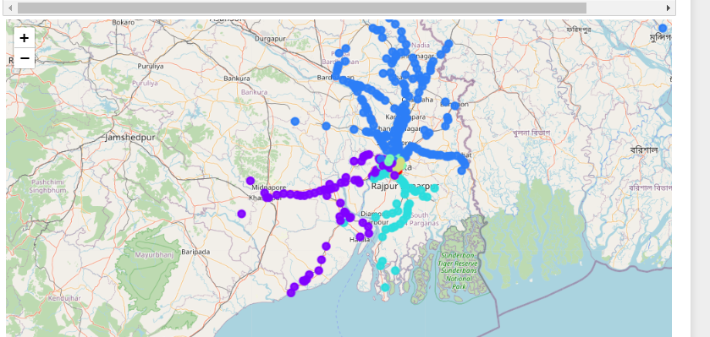
Map showing Kolkata sub-urban Railway Stations
The dots represents Train Stations and the color of the dot represent the Train Line.
We found that the list we obtained has all stations in the state of West Bengal rather than only the list of train stations inside Kolkata.

Slide 9
Finding Railway Stations inside and in the nearby outskirts of Kolkata
In order to find list of Stations inside the Kolkata city and its nearby outskirts, we selected four Train Stations at the extreme boundaries in four directions of the Kolkata city from the map and then we selected all the stations that falls within that boundary in the following manner:
With this we are left with 65 stations, within the city of Kolkata and its outskirts.
Boundary | Station at the extreme Boundary | Logic
South | Sonarpur Junction | Latitude should be >= Latitude of Sonarpur Junction
North | New Barrackpore | Latitude should be <= Latitude of New Barrackpore
West | Santragachi Junction | Longitude should be >= Longitude of Santragachi Junction
East | Barasat Junction | Longitude should be <= Longitude of Barasat Junction

Slide 10
FourSquare API
Next step would be to find out all the venues around these stations, for which ‘Explore’ functionality of Foursquare API is used.
We requested top 100 venues within 1.5 Km radius of each stations.
Total 882 venues are fetched, with all Stations fetching less than 100 venues around it.
This signifies that the result is all encompassing i.e., the result contains all possible venues within 1.5Km radius from each station that are present in Foursquare dataset.

Slide 11
Assumptions:
Now in order to pin point on areas where the service need to be targeted, we will make two assumptions:
We will assume that Dabbawala service demand would be substantial at areas with high concentration of Office places, where people would need homemade food during their lunch time. These are areas where due to high demand for food service, concentration of restaurants is also very high. Generally office buildings are highly concentrated in commercial places which would have high concentration of Banks, ATMs and other Financial services. Therefore our target location would be areas with high concentration of Offices, Restaurants, Banks, ATM, and Other Financial services.
Similarly we will assume that areas from where house wives could be recruited for cooking are residential areas. And residential area are places where concentration of residential apartments, parks, departmental stores(grocery stores in India), sweet shops (specially in case of city of Kolkata) are high.

Slide 12
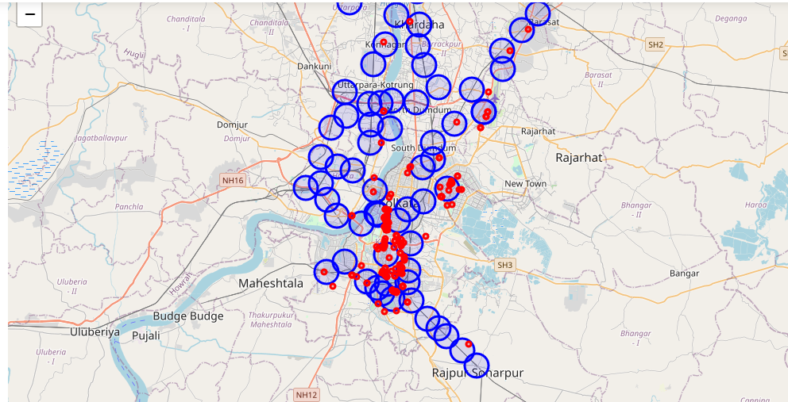
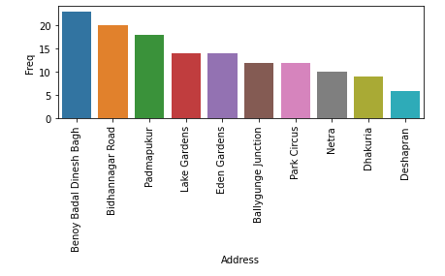
Visualizing the area of high demand of the service
Categories from assumption 1 ,plotted on the map as red dots. Blue circles denotes the Stations and its nearby areas.
Stations around which the concentration of categories mentioned in Assumption 1 are high are as follow:
These are the stations around which demand for the service would be highest.

Slide 13
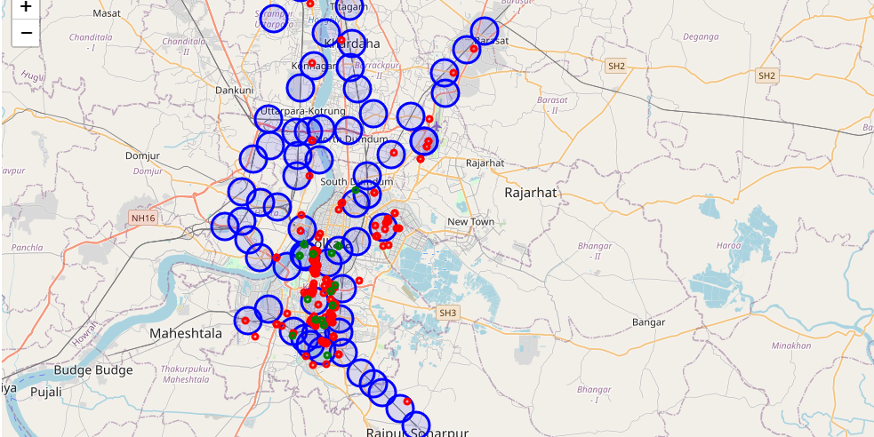
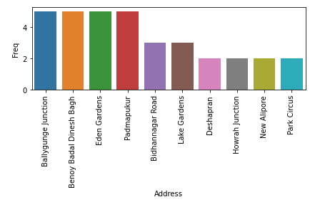
Visualizing the area from where cooks to be recruited
Similarly we find the Stations around which the categories mentioned in the assumption 2 is high. These are plotted as green dots.
Stations around which the concentration of categories mentioned in Assumption 2 are high are as follow:
These are the stations around which cooks could be recruited.

Slide 14
Target Station for the Business
We see that the location of service target as well as that of residential area is either overlapping or very close to each other, which is very optimal for the business as it would further squeeze the commutation cost.
Therefore in accordance with the above two graphs the target Station for our business are as follow:
Name of the Stations of Importance:
Bidhannagar Road
Ballygunge Junction
Benoy Badal Dinesh Bagh
Eden Gardens
Lake Gardens
Park Circus
Barasat Junction
Padmapukur
Deshapran
Dhakuria
Netra

Slide 15
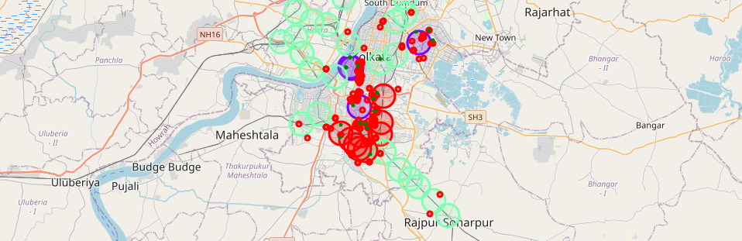
Machine Learning
Now in order to have a better understanding of different areas, understand the scope of future growth and better planning of the business we would group all the stations in three clusters based on the venues that are found within 1.5km of its radius.
We used one hot encoding and KMean algorithm to group the Stations into three clusters based on the Categories of Venues found in the 1.5Km radius of each Station.
The large circles denotes the stations and their color denotes different clusters; the red dots are venues which implies high demand for the service and the green dots represent residential areas from where cooks could recruited. [Cluster 0: Red circles, Cluster 1: Blue Circles, Cluster 2: Cyan Circles]

Slide 16
RESULT
The concentration of red dots and green dots (signifying the target area for the service delivery and cook recruitment target areas) are high at Cluster 0 and Cluster 1. Also we find that all of our Stations of Importance falls in these two clusters. Thus the Dabbawala service can be targeted in Cluster 0 and Cluster 1.
Observation:
Cluster 0: Denoted by Red circles in above map . It has areas with good demand for food as there are many Restaurants, cafes and food places. They also seem to have many clothing store, shopping malls and Movie Theaters. Also as could be seen in the previous map it has maximum numbers of red and green dots, making it very good locations for the business.
Cluster 1: Denoted by Blue circles in the map .It also consists of areas with very high demand for food as it has mostly Restaurants, Hotels, Pubs and Nightclubs. These areas also have high concentration of red and green dots making it good for the business.
Cluster 2: Denoted by Cyan circles in the map above. They seem to be in the outskirts of Kolkata city and do not have much data to contribute.

Slide 17
Stations of Importance along with thir Line and Cluster:
We find the clusters and the Line where our Station of Importance falls:
Station Name | Line | Cluster
Bidhannagar Road | Chord link Line | 0
Ballygunge Junction | Circular Line | 0
Benoy Badal Dinesh Bagh | Circular Line | 0
Eden Gardens | Circular Line | 1
Lake Gardens | Circular Line | 0
Park Circus | Circular Line | 0
Barasat Junction | Eastern Line | 2
Padmapukur | Eastern Line | 1
Deshapran | Eastern Line | 0
Dhakuria | South Lines | 0
Netra | South Lines | 0

Slide 18
RECOMMENDATION
It is recommended that initially business of Dabawala service be targeted at those stations in Cluster 0 and Cluster 1 which falls in ‘Circular Line’.
Therefore Aggressive advertisement be targeted in Stations of Binoy Badal Dinesh Bagh, Lake Gardens, Park Circus, Eden Garden and Ballygynj Junction.
For future growth of the network, more stations from Circular Line in Cluster 0 and Cluster 1 could be targeted.
Eventually Stations in Cluster 0 and Cluster 1 in Lines like Eastern Line and South Line could be targeted.

Slide 19
CONCLUSION
We find that the area where the service would have the highest demand are not very far from each other and are mostly concentrated around stations in Circular Line.
Also Stations along this very Circular Line has many residential area which are potential ground to recruit cooks. This is the best case scenario for starting this business.
Also Dabbawala service has great prospect in the city of Kolkata due to many reasons like good intracity train connectivity, huge demand for quality food .
It provides an opportunity for many women to rightfully become a part of the work force, cooking the same quality food that they already cook for their own family.
This Service could be a good competition for online delivery services. Although the Dabbawala service would mostly be a niche service catering mostly to men and women who would need a regular lunch service with guaranteed good quality.

Slide 20
Thank You

